Slide 1
Gencove
Low coverage sequencing with imputation as an alternative traditional methods

Slide 2
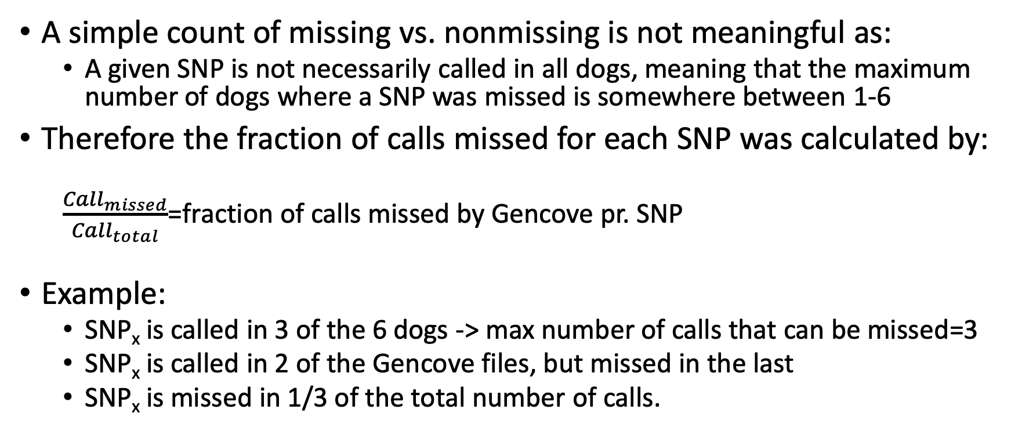
Distribution of missing SNPs
A simple count of missing vs. nonmissing is not meaningful as:
A given SNP is not necessarily called in all dogs, meaning that the maximum number of dogs where a SNP was missed is somewhere between 1-6
Therefore the fraction of calls missed for each SNP was calculated by:
$\frac{{Call}_{missed}}{{Call}_{total}}$=fraction of calls missed by Gencove pr. SNP
Example:
SNP_{x} is called in 3 of the 6 dogs -> max number of calls that can be missed=3
SNP_{x} is called in 2 of the Gencove files, but missed in the last
SNP_{x} is missed in 1/3 of the total number of calls.
Zoom in on fraction 0.1-0.6
Zoom in on fraction 0.1-0.6

Slide 3
Distribution of missing SNPs
% of calls missed by Gencove | 0% | 16% | 20% | 25% | 33% | 40% | 50% | 60% | 66% | 75% | 80% | 83% | 100%
Number of SNPs | 5885919 | 57041 | 59994 | 57566 | 57677 | 8571 | 59703 | 2428 | 8037 | 2278 | 850 | 435 | 2645502
For 5885919 SNPs, Gencove called the SNP in all dogs where they were called
For 2645502 SNPs, Gencove missed the call in all dogs where they were called

Slide 4
Distribution of missing SNPs
% missed samples | 16% | 20% | 25% | 33% | 40% | 50% | 60% | 66% | 75% | 80% | 83% | 100%
Number of SNPs | 57041 | 59994 | 57566 | 57677 | 8571 | 59703 | 2428 | 8037 | 2278 | 850 | 435 | 2645502
% of all SNPs missed | 2% | 2% | 2% | 2% | 0% | 2% | 0% | 0% | 0% | 0% | 0% | 89%
2% of all missed SNPs are missed in 16% of the dogs
89% of SNPs that are missed are missed in all dogs with a call in that variant

Slide 5
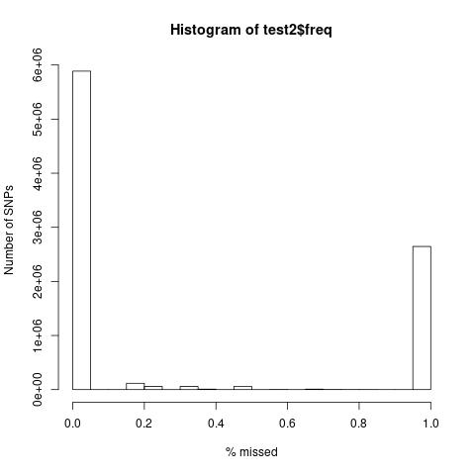
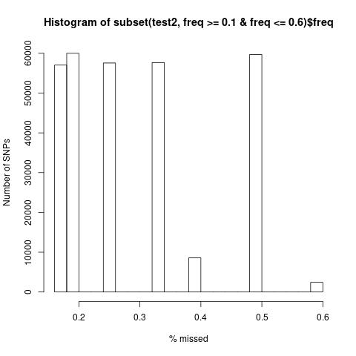
Distribution of missing SNPs
Histogram of missed SNPs
Zoom in on fraction 0.1-0.6
Most calls are either missed by Gencove in
No dogs
or in
All dogs

Slide 6
Distribution of missing SNPs
Histogram of missed SNPs
Zoom in on fraction 0.1-0.6

Slide 7
Distribution of missing SNPs - Conclusion
Due to the differences between the samples at high coverage, a count of missed vs called is not meaningful
The same SNPs are missed by Gencove between dogs
No obvious chromosomes with a higher miss rate (data not shown)

